Slide 1
ADVERSARIAL SEARCH
Course Code: CSC4226
Course Title: Artificial Intelligence and Expert System
Dept. of Computer Science
Faculty of Science and Technology
Lecture No: | Six (6) | Week No: | Six(6) | Semester:
Lecturer: | Dr. Muhammad Firoz Mridha, Associate Professor, Dept of CS Email: firoz.mridha@aiub.edu

Slide 2
Lecture Outline
Game and Its Components
Game as a Search Problem
Perfect Decision in Two Players Games
MiniMax Algorithm
Imperfect Decision
Cutoff Search
Alpha-Beta Pruning

Slide 3
Game Playing: Introduction
We cover competitive environments, in which the agents’ goals are in conflict, giving rise to adversarial search problems—often known as games.
Mathematical game theory, a branch of economics, views any multiagent environment as a game, provided that the impact of each agent on the others is “significant,” regardless of whether the agents are cooperative or competitive
In AI, the most common games are of a rather specialized kind—what game theorists call deterministic, turn-taking, two-player, zero-sum games of perfect information (such as chess).
In our terminology, this means deterministic, fully observable environments in which two agents act alternately and in which the utility values at the end of the game are always equal and opposite.

Slide 4
Chess as a First Choice
It provides proof that a machine can do something that was thought to require intelligence.
It has simple rules.
The world state is fully accessible to the program.
The computer representation can be correct in every relevant detail.

Slide 5
Games a Search Problem
Some games can normally be defined in the form of a tree.
Branching factor is usually an average of the possible number of moves at each node.
This is a simple search problem: a player must search this search tree and reach a leaf node with a favorable outcome.

Slide 6
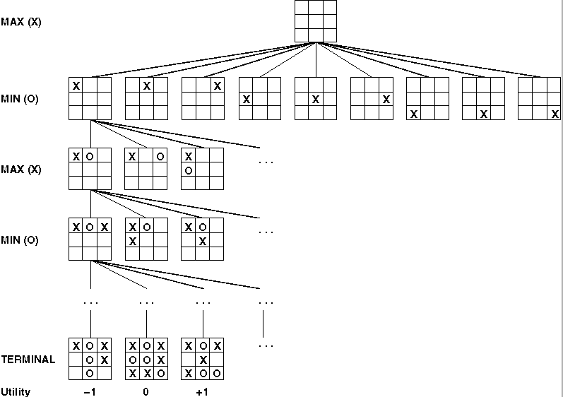
Tic-Tac-Toe

Slide 7
Components of a Game
Initial state: Set-up specified by the rules, e.g., initial board configuration of chess.
Player(s): Defines which player has the move in a state.
Actions(s): Returns the set of legal moves in a state.
Result(s , a): Transition model defines the result of a move.
(2nd ed.: Successor function: list of (move , state) pairs specifying legal moves.)
Terminal-Test(s): Is the game finished? True if finished, false otherwise.
Utility function(s , p): Gives numerical value of terminal state s for player p.
E.g., win (+1), lose (-1), and draw (0) in tic-tac-toe.
E.g., win (+1), lose (0), and draw (1/2) in chess.

Slide 8
Two Player Game
Two players: Max and Min
Objective of both Max and Min to optimize winnings
Max must reach a terminal state with the highest utility
Min must reach a terminal state with the lowest utility
Game ends when either Max and Min have reached a terminal state
upon reaching a terminal state points maybe awarded or sometimes deducted

Slide 9
Search Problem Revisited
Simple problem is to reach a favorable terminal state
Problem Not so simple...
Max must reach a terminal state with as high a utility as possible regardless of Min’s moves
Max must develop a strategy that determines best possible move for each move Min makes.

Slide 10
Tic-Tac-Toe Revisited

Slide 11
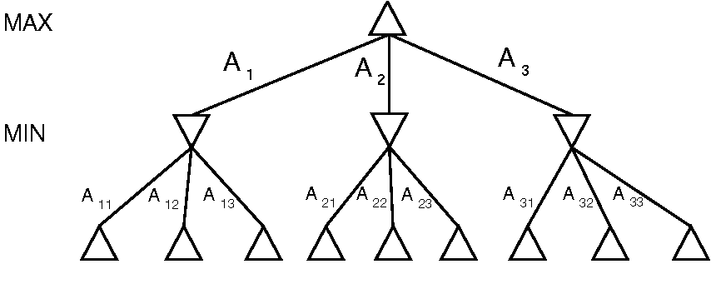
Example: Two-Ply Game
Minimax Decision - maximizes the utility for Max based on the assumption that Min will attempt to Minimize this utility.

Slide 12
Minimax Algorithm
Minimax Algorithm determines optimum strategy for Max:
1. Generate the whole game tree, down to the leaves.
2. Apply utility (payoff) function to each leaf.
3. Use the utility of the terminal states to determine the utility of the nodes one level higher up in the search tree.
3. Back-up values from leaves through branch nodes:
a Max node computes the Max of its child values
a Min node computes the Min of its child values
4. At root: choose the move leading to the child of highest value.

Slide 13
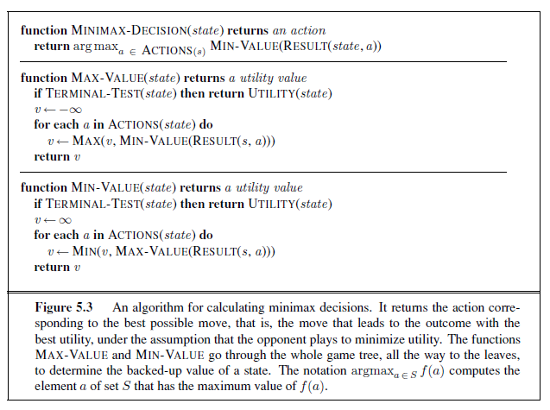
MiniMax Pseudocode

Slide 14
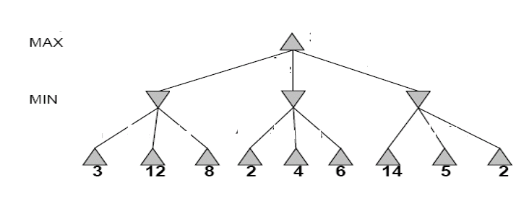
Two-Ply Game Tree

Slide 15
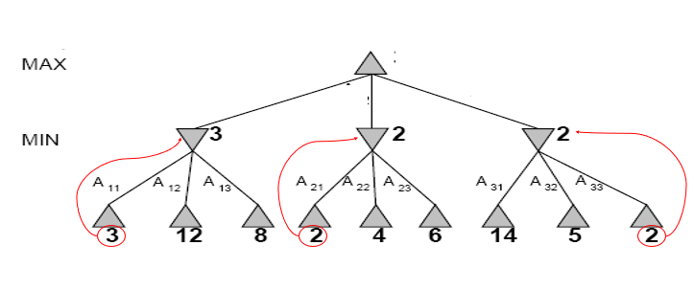
Two-Ply Game Tree

Slide 16
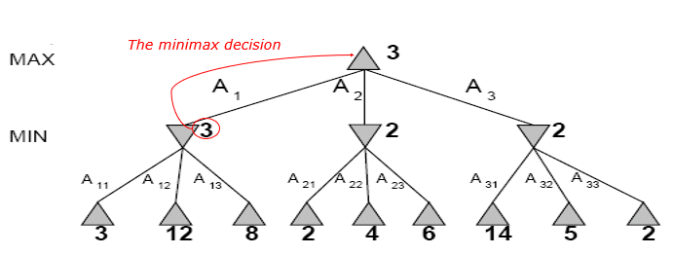
Two-Ply Game Tree

Slide 17
Properties of minimax
Complete?
Yes (if tree is finite).
Optimal?
Yes (against an optimal opponent). Can it be beaten by an opponent playing sub-optimally?
No. (Why not?)
Time complexity?
O(b^{m})
Space complexity?
O(bm) (depth-first search, generate all actions at once)
O(m) (backtracking search, generate actions one at a time)

Slide 18
Game Tree Size
Tic-Tac-Toe
b ≈ 5 legal actions per state on average, total of 9 plies in game.
“ply” = one action by one player, “move” = two plies.
5⁹ = 1,953,125
9! = 362,880 (Computer goes first)
8! = 40,320 (Computer goes second)
→ exact solution quite reasonable
Chess
b ≈ 35 (approximate average branching factor)
d ≈ 100 (depth of game tree for “typical” game)
b^{d} ≈ 35¹⁰⁰ ≈ 10¹⁵⁴ nodes!!
→ exact solution completely infeasible
It is usually impossible to develop the whole search tree.

Slide 19
Is There Another Way?
Take Chess on average has:
35 branches and
usually at least 100 moves
so game space is:
35¹⁰⁰
Is this a realistic game space to search?
Since time is important factor in gaming searching this game space is highly undesirable

Slide 20
Imperfect Decisions
Many game produce very large search trees.
Without knowledge of the terminal states the program is taking a guess as to which path to take.
Cutoffs must be implemented due to time restrictions, either by computer or game situations.

Slide 21
Evaluation Functions
A function that returns an estimate of the expected utility of the game from a given position.
Given the present situation give an estimate as to the value of the next move.
The performance of a game-playing program is dependant on the quality of the evaluation functions.

Slide 22
How to Judge Quality
Evaluation functions must agree with the utility functions on the terminal states.
It must not take too long ( trade off between accuracy and time cost).
Should reflect actual chance of winning.

Slide 23
Design of Evaluation Function
Different evaluation functions must depend on the nature of the game.
Encode the quality of a position in a number that is representable within the framework of the given language.
Design a heuristic for value to the given position of any object in the game.

Slide 24
Material Advantage Evaluation Functions
Values of the pieces are judge independent of other pieces on the board. A value is returned base on the material value of the computer minus the material value of the player.
Weighted Linear Functions
W₁f₁+w₂f₂+……w_{n}f_{n}
W’s are weight of the pieces
F’s are features of the particular positions

Slide 25
Heuristic Evaluation Functions
An Evaluation Function:
Estimates how good the current board configuration is for a player.
Typically, evaluate how good it is for the player, how good it is for the opponent, then subtract the opponent’s score from the players.
Often called “static” because it is called on a static board position.
Othello: Number of white pieces - Number of black pieces
Chess: Value of all white pieces - Value of all black pieces
Typical values from -infinity (loss) to +infinity (win) or [-1, +1].
If the board evaluation is X for a player, it’s -X for the opponent
“Zero-sum game”

Slide 26
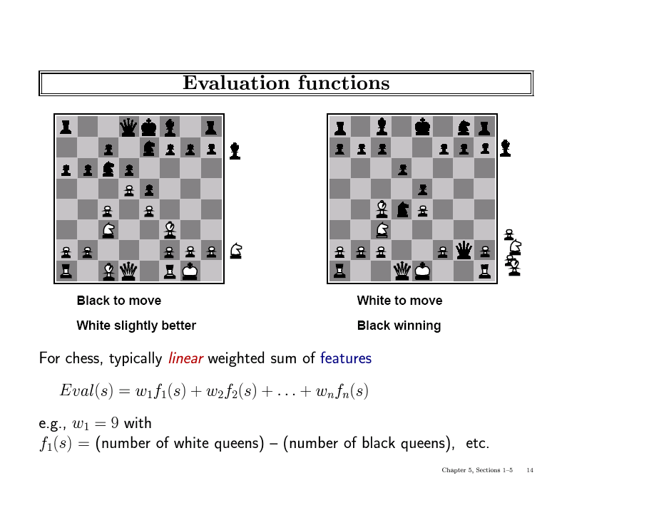
Topic Heading..

Slide 27
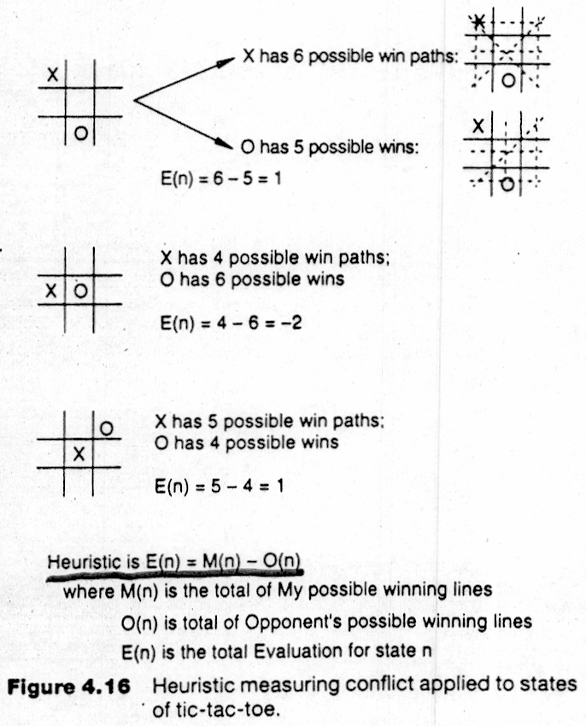
Heuristic evaluation function for tic-tac-toe

Slide 28
Cutoff Search
Cutting of searches at a fixed depth dependent on time
The deeper the search the more information is available to the program the more accurate the evaluation functions
Iterative deepening – when time runs out return the program returns the deepest completed search.
Is searching a node deeper better than searching more nodes?

Slide 29
Consequences
Evaluation function might return an incorrect value.
If the search in cutoff and the next move results involves a capture, then the value that is return maybe incorrect.
Horizon problem
Moves that are pushed deeper into the search trees may result in an oversight by the evaluation function.

Slide 30
Improvements to Cutoff
Evaluation functions should only be applied to quiescent position.
Quiescent Position : Position that are unlikely to exhibit wild swings in value in the near future.
Non quiescent position should be expanded until quiescent position is reached. This extra search is called a Quiescence search.
Will provide more information about that one node in the search tree but may result in the lose of information about the other nodes.

Slide 31
Pruning
What is pruning?
The process of eliminating a branch of the search tree from consideration without examining it.
Why prune?
To eliminate searching nodes that are potentially unreachable.
To speedup the search process.

Slide 32
Alpha-Beta Pruning
A technique to find the optimal solution according to a limited depth search using evaluation functions.
Returns the same choice as minimax cutoff decisions but examines fewer nodes.
Gets its name from the two variables that are passed along during the search which restrict the set of possible solutions.

Slide 33
Alpha-beta: Definitions
Alpha –
the value of the best choice so far along the path for MAX.
Beta –
the value of the best choice (lowest value) so far along the path for MIN.

Slide 34
Implementation
Set root node alpha to negative infinity and beta to positive infinity.
Search depth first, propagating alpha and beta values down to all nodes visited until reaching desired depth.
Apply evaluation function to get the utility of this node.
If parent of this node is a MAX node, and the utility calculated is greater than parents' current alpha value, replace this alpha value with this utility.

Slide 35
Implementation (Cont’d)
If parent of this node is a MIN node, and the utility calculated is less than parents' current beta value, replace this beta value with this utility.
Based on these updated values, it compares the alpha and beta values of this parent node to determine whether to look at any more children or to backtrack up the tree.
Continue the depth first search in this way until all potentially better paths have been evaluated.

Slide 36
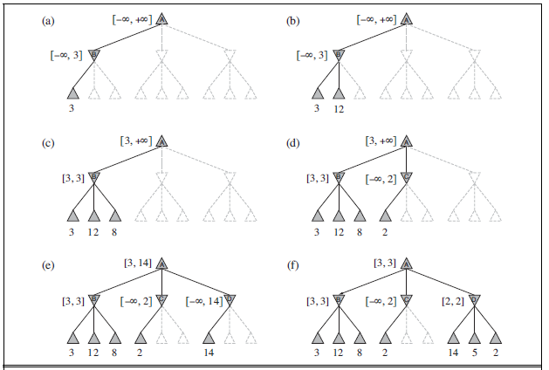
Alpha-Beta Example

Slide 37
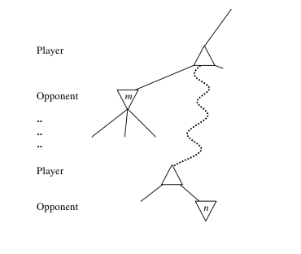
General alpha-beta pruning
Consider a node n in the tree ---
If player has a better choice at:
Parent node of n
Or any choice point further up
Then n will never be reached in play.
Hence, when that much is known about n, it can be pruned.

Slide 38
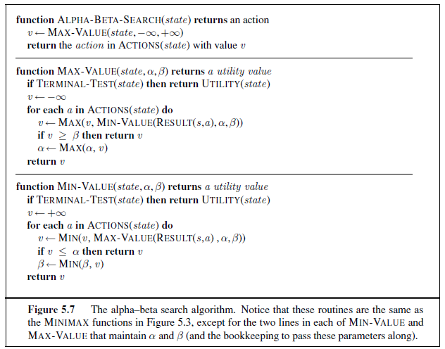
Alpha-Beta Search Algorithm

Slide 39
When to Prune
Prune whenever α ≥ β.
Prune below a Max node whose alpha value becomes greater than or equal to the beta value of its ancestors.
Max nodes update alpha based on children’s returned values.
Prune below a Min node whose beta value becomes less than or equal to the alpha value of its ancestors.
Min nodes update beta based on children’s returned values.

Slide 40
Effectiveness of Alpha-Beta Search
Worst-Case
branches are ordered so that no pruning takes place. In this case alpha-beta gives no improvement over exhaustive search
Best-Case
each player’s best move is the left-most child (i.e., evaluated first)
in practice, performance is closer to best rather than worst-case
E.g., sort moves by the remembered move values found last time.
E.g., expand captures first, then threats, then forward moves, etc.
E.g., run Iterative Deepening search, sort by value last iteration.
In practice often get O(b^{(d/2)}) rather than O(b^{d})
this is the same as having a branching factor of sqrt(b),
(sqrt(b))^{d} = b^{(d/2)},i.e., we effectively go from b to square root of b
e.g., in chess go from b ~ 35 to b ~ 6
this permits much deeper search in the same amount of time

Slide 41
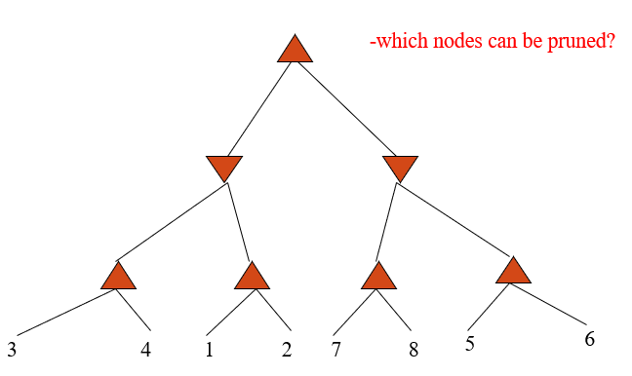
Example

Slide 42
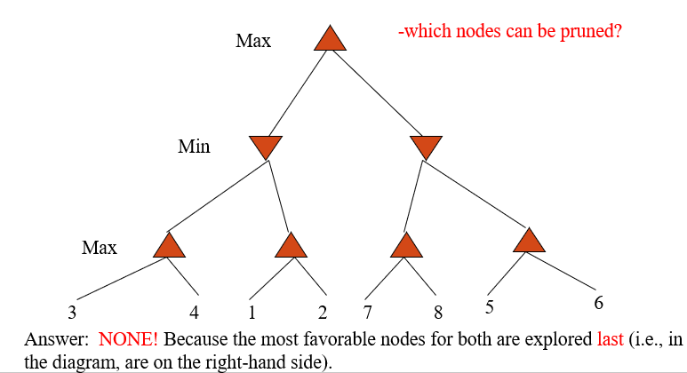
Answer to Example

Slide 43
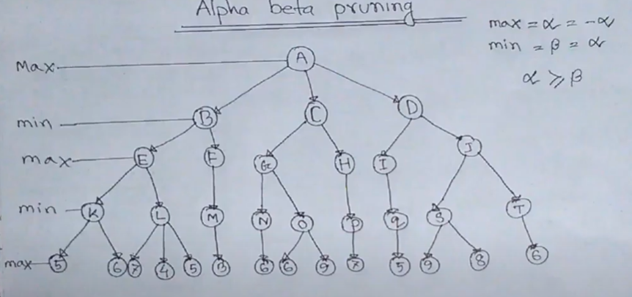
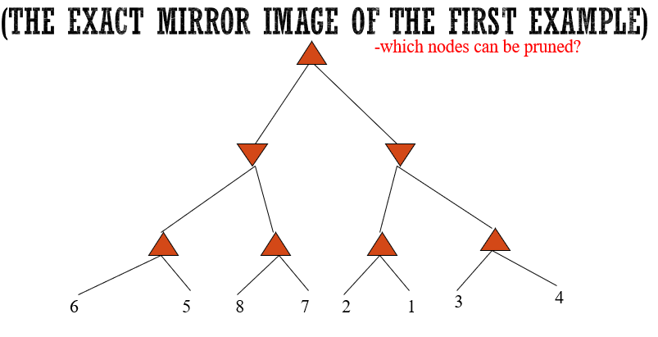
Second Example

Slide 44
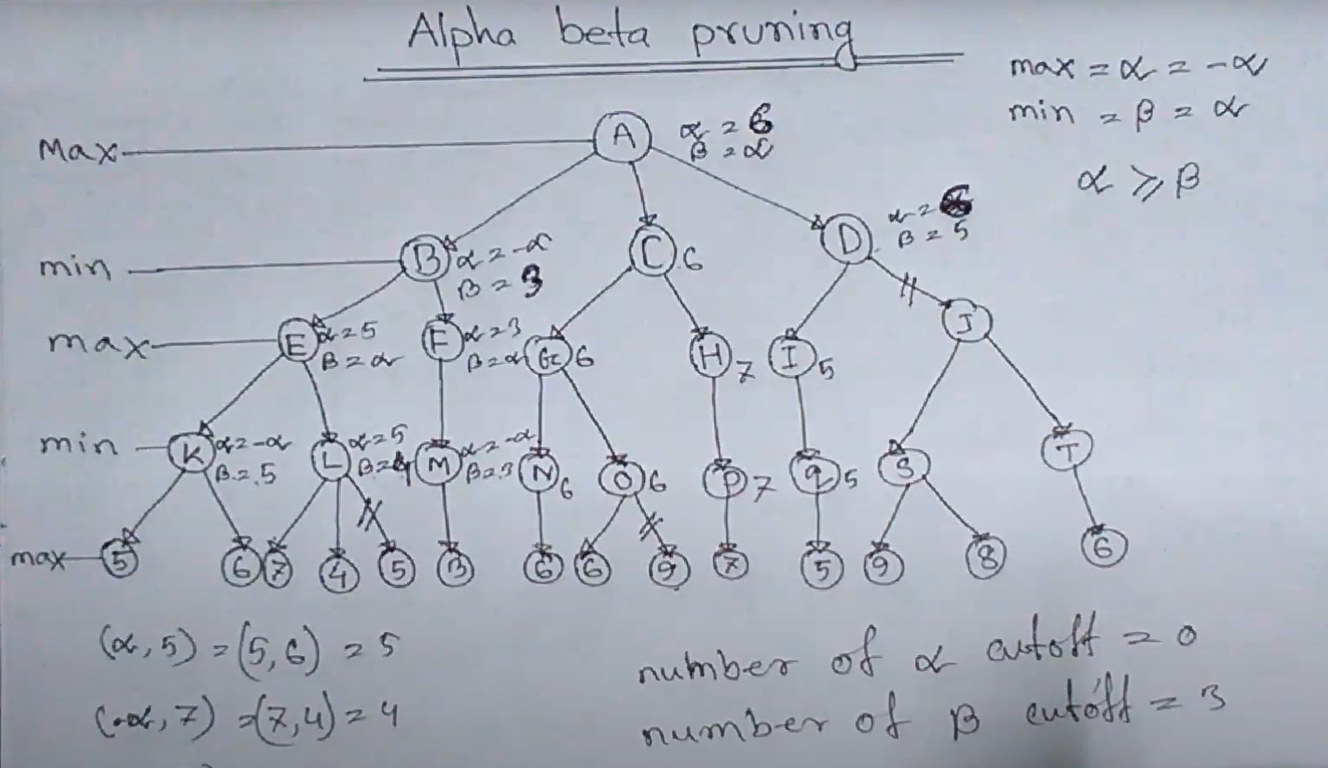

Slide 45
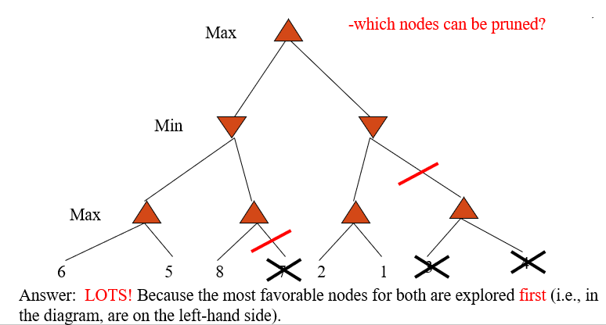
Answer

Slide 46
Final Comments about Alpha-Beta Pruning
Pruning does not affect final results
Entire subtrees can be pruned.
Good move ordering improves effectiveness of pruning
Repeated states are again possible.
Store them in memory = transposition table

Slide 47
Problems
If there is only one legal move, this algorithm will still generate an entire search tree.
Designed to identify a “best” move, not to differentiate between other moves.
Overlooks moves that forfeit something early for a better position later.
Evaluation of utility usually not exact.
Assumes opponent will always choose the best possible move.

Slide 48
References
Chapter 5: Adversarial Search , Pages 161-176
“Artificial Intelligence: A Modern Approach,” by Stuart J. Russell and Peter Norvig,

Slide 49
Books
“Artificial Intelligence: A Modern Approach,” by Stuart J. Russell and Peter Norvig.
"Artificial Intelligence: Structures and Strategies for Complex Problem Solving", by George F. Luger, (2002)
"Artificial Intelligence: Theory and Practice", by Thomas Dean.
"AI: A New Synthesis", by Nils J. Nilsson.
“Programming for machine learning,” by J. Ross Quinlan,
“Neural Computing Theory and Practice,” by Philip D. Wasserman, .
“Neural Network Design,” by Martin T. Hagan, Howard B. Demuth, Mark H. Beale, .
“Practical Genetic Algorithms,” by Randy L. Haupt and Sue Ellen Haupt.
“Genetic Algorithms in Search, optimization and Machine learning,” by David E. Goldberg.
"Computational Intelligence: A Logical Approach", by David Poole, Alan Mackworth, and Randy Goebel.
“Introduction to Turbo Prolog”, by Carl Townsend.

